Slide 1
FLOW RATE OUT OF SPECIFICATION (Error 092) INVESTIGATION - FEB 2020

Slide 2
Issue Definition
What We Know
February Data Analysis
Conclusion and recommendations

Slide 3
Issue Definition
Tickets raised show that there was an increase in the occurrence of error 092 (flow rate out of spec) in the month of Feb 2020 (Link to problem ticket). 64 cases ticketed so far from 1st Feb to 24th Feb; of which some are re-occurrences.
Goal:
To establish why there was a sudden increase in error 092 cases in Feb.
Find ways to mitigate the problem especially the re-occurrences.

Slide 4
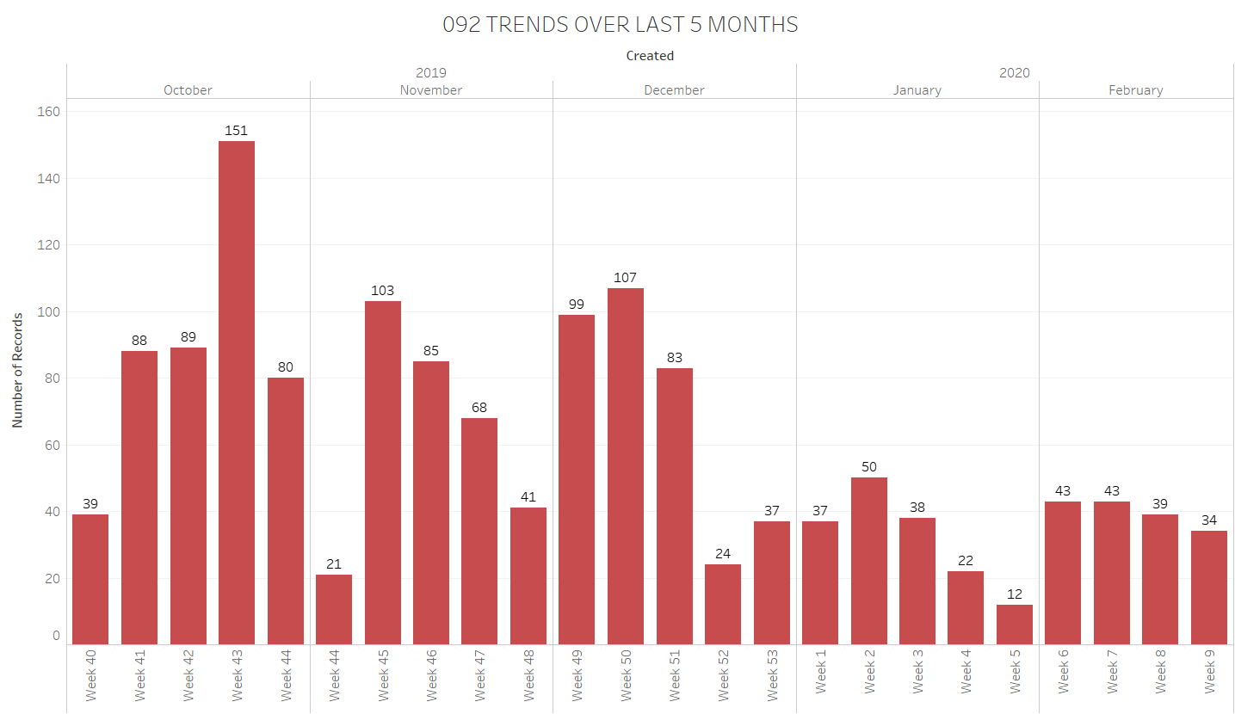
What we know
Frequency of 092 error from October 2019 to February 2020.

Slide 5
What we know Cont’d
Number of 092 incidents reduced by almost 50% over the last 5 months due to the changes implemented in December:
New troubleshooting guide that uses KP and canister flow rate data to find the root cause.
Reducing the flow rate low (FRL) threshold from 1.0L/min to 0.85L/min to cater for canisters with issues, pumps with lower flow rates and KPs affected by low tank levels.
Promotions held in February involving:
Reduction in the price of the KOKO cooker therefore more customers using the KP.
Adjustment of fuel price and free refills give-aways to new customers leading to more dispenses.

Slide 6
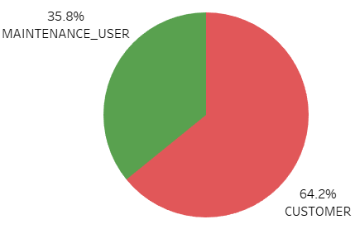
User Type Analysis
35.8% of the errors in Feb were triggered during maintenance activities therefore they will be isolated from the analysis to focus on customer related issue.

Slide 7
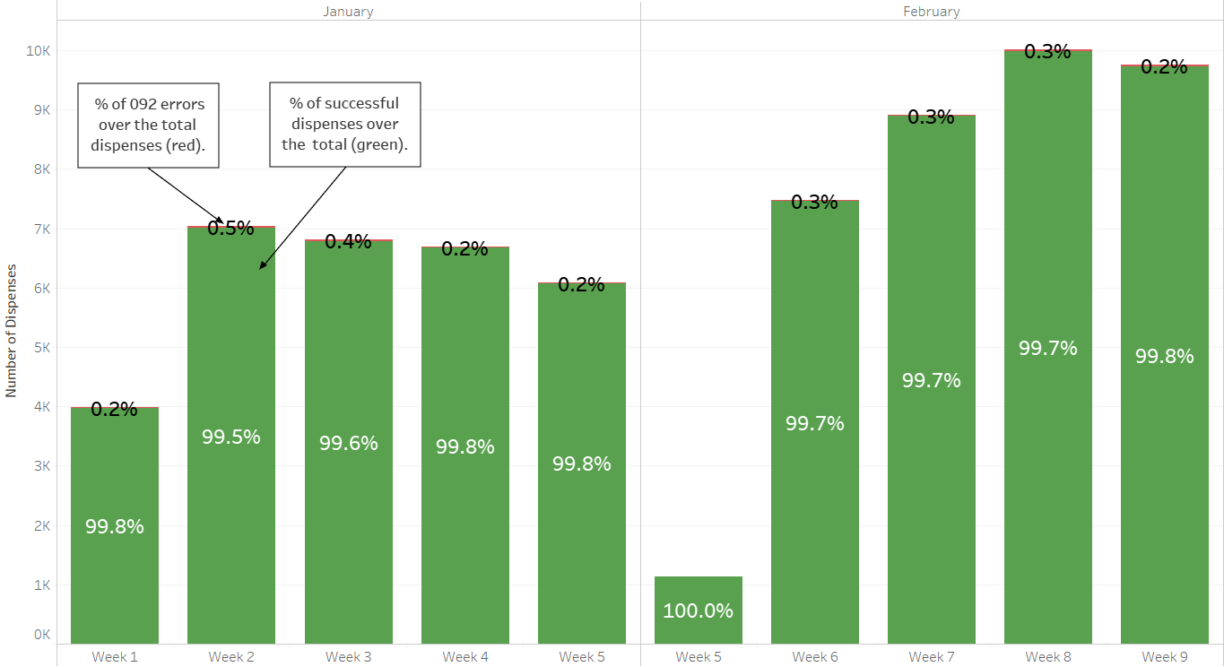
Error 092 vs total dispenses in Jan & Feb Analysis
Objectives: Establish whether the increase of 092 frequency in Feb is related to an increase in total number of dispenses.

Slide 8
Error 092 vs total dispenses in Jan & Feb Analysis Cont’d
Increased dispenses were observed in February than in January due to the increased promotional activities in February.
February had more dispenses(~37,188) as compared to January (~30,524).
The average 092 error percentage has remained at 0.3% despite the increase in customer dispenses

Slide 9
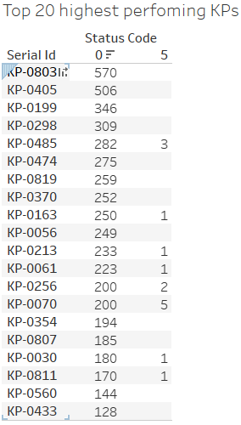
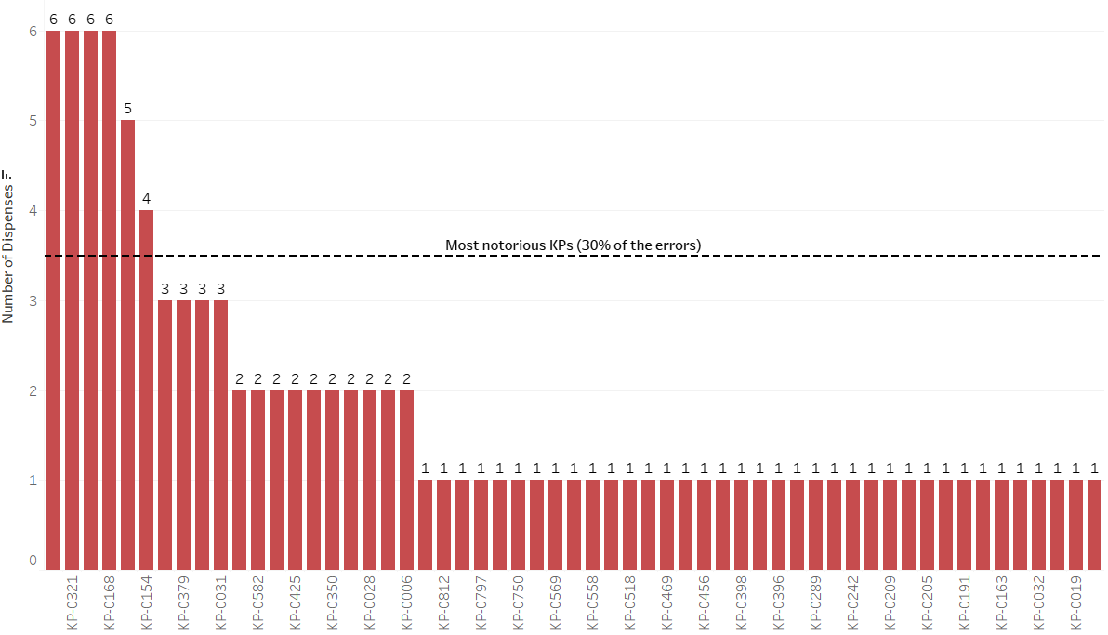
KP Analysis
Objective: To observe the spread of the errors across the KP network in order to investigate KPs with high recurrence rates.

Slide 10
KP Analysis Cont’d
KP-0321, 0442, 0227, 0168 have the highest recurrence rate of 6 (24% of total errors).
These 4 KPs are not among the highest performing KPs in Feb; meaning number of dispenses per KP is not directly related to 092 recurrence rate.

Slide 11
Root Cause Analysis
KP Serial | 092 Failure mode | Freq. | Current findings | Recommendations
KP-0442 | Dispense not started. | 6 | Issue cannot be reproduced. | Loose hardware connection or component working intermittently. Should be investigated using Case 2 of troubleshooting guide. Ticket and field investigation results to be escalated to Production Eng. if issue persists.
KP-0227 | Low flow rate of 0.836L/min | 1 | Clogged SMV | SMV cleaned by Technician
 | Low flow rate of 0.836L/min | 2 | Issue not reproduced. Both dispenses by Eucabeth Adhiambo (300168020). | Specific canister has generally been having low flow rates (0.8 - 0.9) even during successful dispenses. Needs to be retrieved for testing.
 | Low flow rate of 0.3L/min | 3 | KP was out of fuel due to inaccessible road. | Need to establish a KP out of service protocol to notify/prevent customers from dispensing on a KP that is not currently functional.
KP-0168 | Low flow rate of 0.7L/min | 1 | SMV clogged. | KP needs to be monitored for root cause of clogging since pump filter had previously clogged on 14th Jan.
 | Low flow rate of 0.8L/min | 2 | Issue cannot be reproduced. | Still under investigation.
 | Dispense not started | 3 | SMV floods and fuel in air line. | Loose hardware connection or clogged system. Should be investigated using Case 2 of troubleshooting guide. Ticket and field investigation results to be escalated to Production Eng. if issue persists.

Slide 12
Root Cause Analysis Cont’d
KP Serial | 092 Failure mode | Freq. | Current findings | Recommendations
KP-0321 | Low flow rate of 0.236L/min | 1 | Smart valve stuck due to foreign metallic piece jamming the fuel housing. | Resolved by Technician: foreign material removed
 | High flow rates above 1.9L/min | 5 | Pump replaced but no change in behaviour. | Suspected FM / KPC issue. Should be investigated using Case 1 of troubleshooting guide to isolate component.

Slide 13
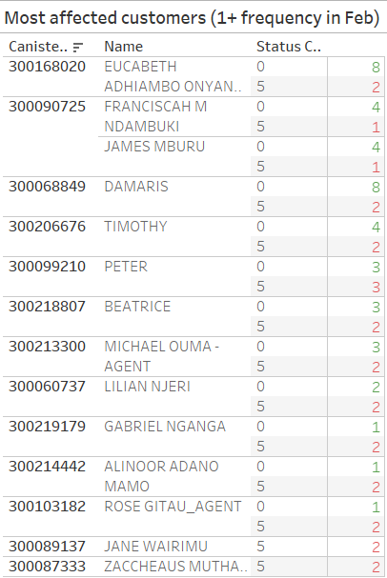
Canister Analysis
Objective: To identify any canisters with a high frequency of 092 occurrences and isolate them if need be.

Slide 14
Canister Analysis Cont’d
11 customers have had more than one incident of 092; whereas two have not had any successful dispenses during the month of February.
Customer name: | Canister | Any successful dispenses | Dispense behaviour trends
JANE WAIRIMU | 300089137 | Yes | 4/11 dispenses on KP-0321 have failed this year (including her last 2).
ZACCHEAUS MUTHAMA | 300087333 | Yes | Last 4 dispenses have been unsuccessful at 2 different KPs.
EUCABETH ADHIAMBO | 300168020 | Yes | Canister has been experiencing low flow rates compared to other customers.

Slide 15
Conclusion and Recommendations
Sudden increase of errors in February were due to the increased sales as a result of promotions.
Maintenance team: The high number of recurrences on the 4 sampled KPs would have been avoided if the Maintenance team would have followed the right troubleshooting procedure as outlined in the guide. This should be adhered to prevent inefficiencies in the process and reduce the errors further down from the current 0.3%.
NOC team: Canisters with frequent 092 issues need to be monitored using the Grafana Issue discovery dashboards provided. Unusual patterns such as low flow rates also need to be flagged and investigated further.
Retraining of the maintenance technicians

